Slide 1
项目管理与质量保证
主讲：左保河

Slide 2
主要内容
Chapter 1 Introduction to Project Management
Chapter 2 The Project Management and Information Technology Context
Chapter 3 The Project Management Process Groups: A Case Study
Chapter 4 Project Integration Management
Chapter 5 Project Scope Management
Chapter 6 Project Time Management
Chapter 7 Project Cost Management

Slide 3
PMBOK V7.0 新增知识域
Chapter 8 Project Quality Management
Chapter 9 Project Human Resource Management
Chapter 10 Project Communications Management
Chapter 11 Project Risk Management
Chapter 12 Project Procurement Management
Chapter 13 Project Stakeholder Management

Slide 4
课程简介
软工五门知识域课和三大核心课程之一
内容：IT项目管理、软件项目质量
IBM PM、系统优化技术
课时：理论课时56
实验课时24
研讨课时8
项目设计8+
成绩：考试60%，平时+设计40%。
教材、工具。

Slide 5

Chapter 1: Introduction to Project Management
Information Technology Project Management, Seventh Edition
Note: See the text itself for full citations.

Slide 6
Learning Objectives
Understand the growing need for better project management, especially for information technology (IT) projects
Explain what a project is, provide examples of IT projects, list various attributes of projects, and describe the triple constraint of project management
Describe project management and discuss key elements of the project management framework, including project stakeholders, the project management knowledge areas, common tools and techniques, and project success

Slide 7
Learning Objectives
Discuss the relationship between project, program, and portfolio management and the contributions each makes to enterprise success
Understand the role of project managers by describing what they do, what skills they need, and career opportunities for IT project managers
Describe the project management profession, including its history, the role of professional organizations like the Project Management Institute (PMI), the importance of certification and ethics, and the advancement of project management software

Slide 8
Introduction
Many organizations today have a new or renewed interest in project management
Computer hardware, software, networks, and the use of interdisciplinary and global work teams have radically changed the work environment
The world as a whole spends nearly $10 trillion of its $40.7 trillion gross product on projects of all kinds
More than 16 million people regard project management as their profession

Slide 9
Project Management Statistics
The overall information and communications technology market grew by 6 percent to almost $3 trillion in 2010
In the U.S. the size of the IT workforce topped 4 million workers in 2008, and the unemployment rate for IT professionals is half the rate for the overall labor market
In 2011 the total compensation for the average senior project manager in U.S. dollars was $105,000 per year in the United States and $160,409 in the Switzerland.
The number of people earning their Project Management Professional (PMP) certification continues to increase. 44 percent of employers listed project management as a skill they looked for in new college grads, behind only communication and technical skills

Slide 10
Motivation for Studying Information Technology (IT) Project Management
IT Projects have a terrible track record, as described in the What Went Wrong?
A 1995 Standish Group study (CHAOS) found that only 16.2% of IT projects were successful in meeting scope, time, and cost goals; over 31% of IT projects were canceled before completion
A PricewaterhouseCoopers study found that overall half of all projects fail and only 2.5% of corporations consistently meet their targets for scope, time, and cost goals for all types of project.

Slide 11
Advantages of Using Formal Project Management
Better control of financial, physical, and human resources
Improved customer relations
Shorter development times
Lower costs
Higher quality and increased reliability
Higher profit margins
Improved productivity
Better internal coordination
Higher worker morale

Slide 12
What Is a Project?
A project is “a temporary endeavor undertaken to create a unique product, service, or result” (PMBOK® Guide, Fifth Edition, 2012)
Operations is work done to sustain the business
Projects end when their objectives have been reached or the project has been terminated
Projects can be large or small and take a short or long time to complete

Slide 13
Examples of IT Projects
A team of students creates a smartphone application and sells it online
A company develops a driverless car
A small software development team adds a new feature to an internal software application for the finance department
A college upgrades its technology infrastructure to provide wireless Internet access across the whole campus

Slide 14
Top Strategic Technologies for 2012 (Gartner)
Media tablets and beyond
Mobile-centric applications and interfaces
Contextual and social user experience
Internet of things
Cloud computing

Slide 15
Media Snapshot: Unproductive Apps
Gartner predicts that by 2014, there will be more than 70 billion mobile application downloads every year
All of the top iPhone apps in early 2012 (Temple Run, Angry Gran, Zombie Farm, Words With Friends, Angry Birds, etc.) and most of the top iPad2 apps can be considered unproductive in most work environments
The challenge is to develop useful apps and get workers to focus on them instead of the many distracting options available

Slide 16
Project Attributes
A project
has a unique purpose
is temporary
is developed using progressive elaboration
requires resources, often from various areas
should have a primary customer or sponsor
The project sponsor usually provides the direction and funding for the project
involves uncertainty

Slide 17
Project and Program Managers
Project managers work with project sponsors, project team, and other people involved in a project to meet project goals
Program: group of related projects managed in a coordinated way to obtain benefits and control not available from managing them individually (PMBOK® Guide, Fifth Edition, 2012)
Program managers oversee programs; often act as bosses for project managers

Slide 18
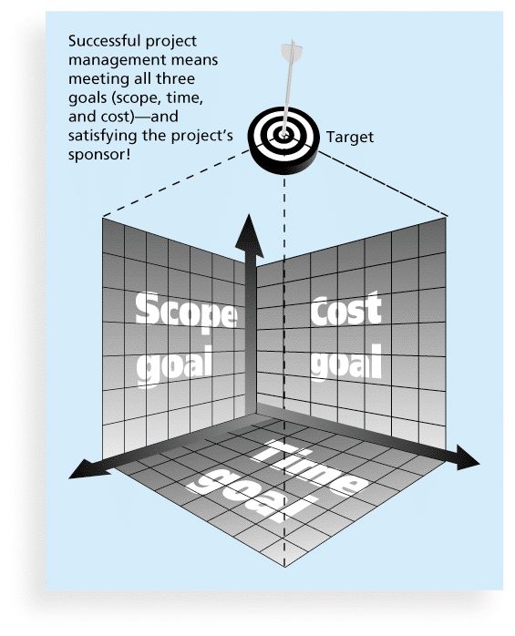
Figure 1-1 The Triple Constraint of Project Management

Slide 19
What is Project Management?
Project management is “the application of knowledge, skills, tools and techniques to project activities to meet project requirements” (PMBOK® Guide, Fourth Edition, 2012)
Project managers strive to meet the triple constraint (project scope, time, and cost goals) and also facilitate the entire process to meet the needs and expectations of project stakeholders

Slide 20
什么是管理？
所谓管理，就是使人们完成特定任务的艺术
---Mary Parker Follett。
为组织提供指导、领导权并决定如何利用组织资源去完成目标的活动---Petter Drucker
管理的核心职能
计划（Plan）、组织（Organize）、领导（Command） 、控制（Control）
计划、组织、领导 、控制、协调（Coordinate）
管理是决策、计划、组织、执行、控制

Slide 21
计划
目标
资源
组织
控制
领导

Slide 22
管理的两面性及其辩证统一关系
管理的艺术性
---人品、性格、形象、口才、鼓动、前瞻等等。
管理的技术性
---领域知识、分解、协调、优化、过程、目标
管理是艺术性与技术性的统一。

Slide 23
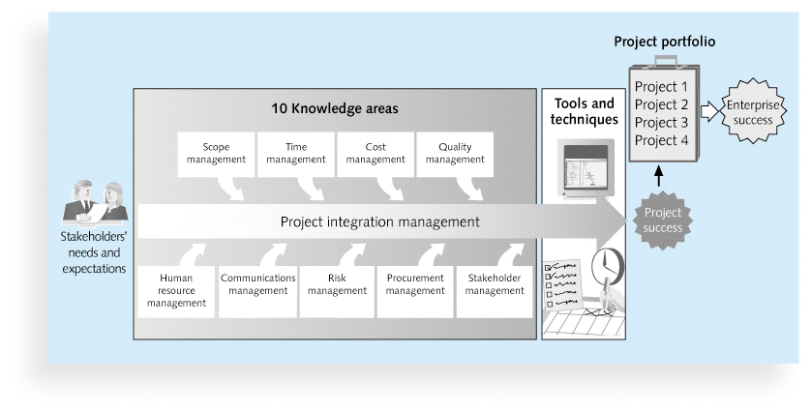
Figure 1-2 Project Management Framework

Slide 24
Project Stakeholders
Stakeholders are the people involved in or affected by project activities
Stakeholders include
the project sponsor
the project manager
the project team
support staff
customers
users
suppliers
opponents to the project

Slide 25
10 Project Management Knowledge Areas
Knowledge areas describe the key competencies that project managers must develop
Project managers must have knowledge and skills in all 10 knowledge areas (project integration, scope, time, cost, quality, human resource, communications, risk, procurement, and stakeholder management)
This text includes an entire chapter on each knowledge area

Slide 26
Project Management Tools and Techniques
Project management tools and techniques assist project managers and their teams in various aspects of project management
Some specific ones include
Project charter, scope statement, and WBS (scope)
Gantt charts, network diagrams, critical path analysis, critical chain scheduling (time)
Cost estimates and earned value management (cost)
See Table 1-1 for many more

Slide 27
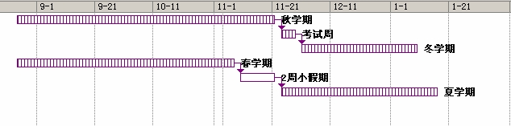
Super Tools
“Super tools” are those tools that have high use and high potential for improving project success, such as:
Software for task scheduling (such as project management software)
Scope statements
Requirements analyses
Lessons-learned reports
Tools already extensively used that have been found to improve project importance include:
Progress reports
Kick-off meetings
Gantt charts
Change requests
图1 四学期计划分时图

Slide 28
多次谈判协商模型系统
项目任务分解
1.0 启动
1.1 确定/指定项目经理
1.2 确定利益相关者
1.3 准备可行性分析
1.4 编制项目章程
2.0 计划
2.1 召开项目规划会议
2.2 编写范围说明书
2.3 制定工作分解结构
2.4 准备进度表
2.4.1 确定任务期限
2.4.2 确定任务依赖关系
2.4.3 制作甘特图
2.4.4审查并确定甘特图
2.5 辨识、讨论和排列风险

Slide 29
2.6编制项目计划
2.7 需求分析
2.7.1 需求调查
2.7.2 编写需求归约说明书
3.0 实施
3.1 编制概要设计说明书
3.2编制详细设计说明书
3.3 编制数据库设计说明书
4.0 监测与控制
4.1 状态报告
5.0 收尾
5.1 准备项目最终报告
5.2 总结教训

Slide 30
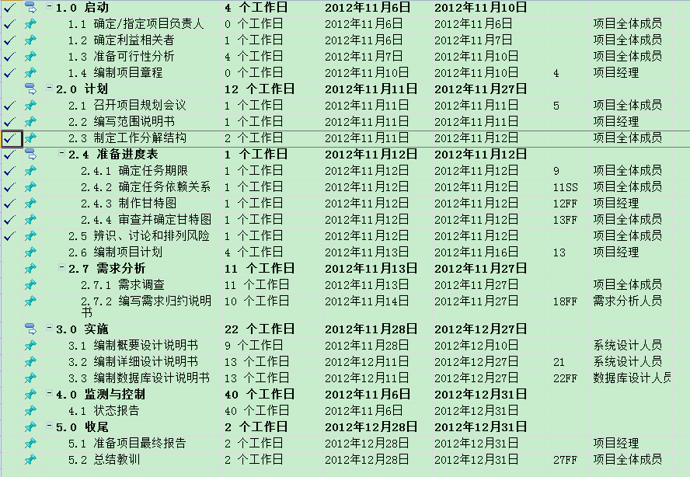
时间安排

Slide 31
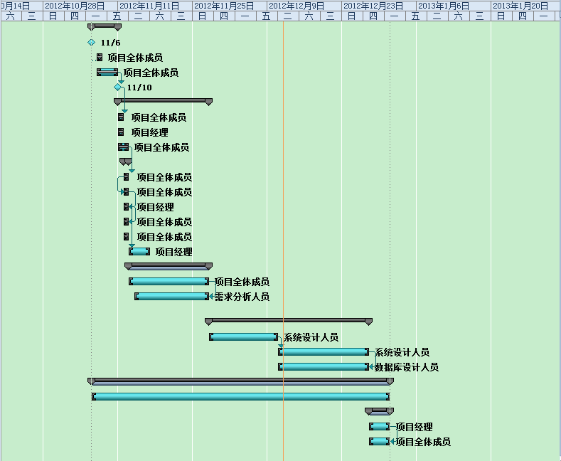
甘特图

Slide 32
What Went Right? Improved Project Performance
The Standish Group’s CHAOS studies show improvements in IT projects in the past decade:
The number of successful IT projects has more than doubled, from 16 percent in 1994 to 37 percent in 2010
The number of failed projects decreased from 31 percent in 1994 to 21 percent in 2010
Success rates were the highest ever in the most recent CHAOS study

Slide 33
Why the Improvements?
"The reasons for the increase in successful projects vary. First, the average cost of a project has been more than cut in half. Better tools have been created to monitor and control progress and better skilled project managers with better management processes are being used. The fact that there are processes is significant in itself.”*
*Standish Group, "CHAOS 2001: A Recipe for Success" (2001).

Slide 34
Project Success
There are several ways to define project success:
The project met scope, time, and cost goals
The project satisfied the customer/sponsor
The results of the project met its main objective, such as making or saving a certain amount of money, providing a good return on investment, or simply making the sponsors happy

Slide 35
Table 1-2: What Helps Projects Succeed?*
1. User involvement
2. Executive support
3. Clear business objectives
4. Emotional maturity
5. Optimizing scope
6. Agile process
7. Project management expertise
8. Skilled resources
9. Execution
10. Tools and infrastructure
*The Standish Group, “CHAOS Activity News” (August 2011).

Slide 36
Top Three Reasons Why Federal Technology Project Succeed
Adequate funding
Staff expertise
Engagement from all stakeholders

Slide 37
What the Winners Do…
Recent research findings show that companies that excel in project delivery capability:
Use an integrated project management toolbox (use standard/advanced PM tools, lots of templates)
Grow project leaders, emphasizing business and soft skills
Develop a streamlined project delivery process
Measure project health using metrics, like customer satisfaction or return on investment

Slide 38
Program and Project Portfolio Management
A program is “a group of related projects managed in a coordinated way to obtain benefits and control not available from managing them individually” (PMBOK® Guide, Fifth Edition, 2012)
A program manager provides leadership and direction for the project managers heading the projects within the program
Examples of common programs in the IT field include infrastructure, applications development, and user support

Slide 39
Project Portfolio Management
As part of project portfolio management, organizations group and manage projects and programs as a portfolio of investments that contribute to the entire enterprise’s success
Portfolio managers help their organizations make wise investment decisions by helping to select and analyze projects from a strategic perspective

Slide 40
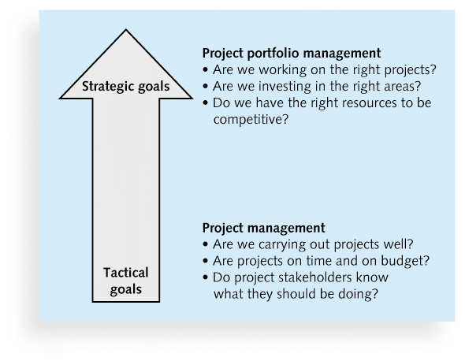
Figure 1-3. Project Management Compared to Project Portfolio Management

Slide 41
Best Practice
A best practice is “an optimal way recognized by industry to achieve a stated goal or objective”*
Robert Butrick suggests that organizations need to follow basic principles of project management, including these two mentioned earlier in this chapter:
Make sure your projects are driven by your strategy. Be able to demonstrate how each project you undertake fits your business strategy, and screen out unwanted projects as soon as possible
Engage your stakeholders. Ignoring stakeholders often leads to project failure. Be sure to engage stakeholders at all stages of a project, and encourage teamwork and commitment at all times
*Project Management Institute, Organizational Project Management Maturity Model
(OPM3) Knowledge Foundation (2003), p. 13.

Slide 42
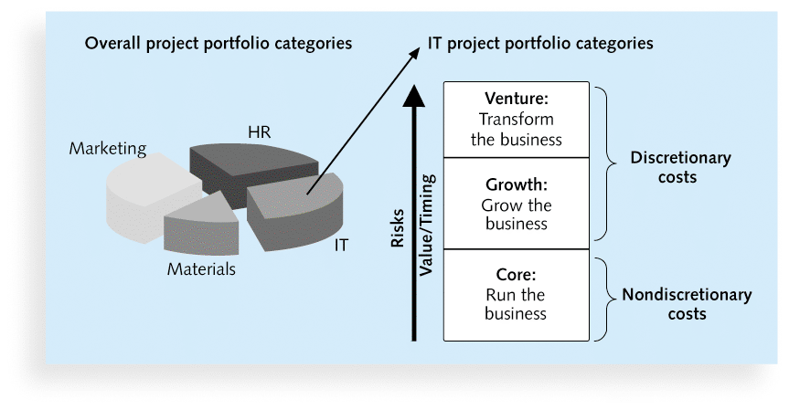
Figure 1-4. Sample Project Portfolio Approach

Slide 43
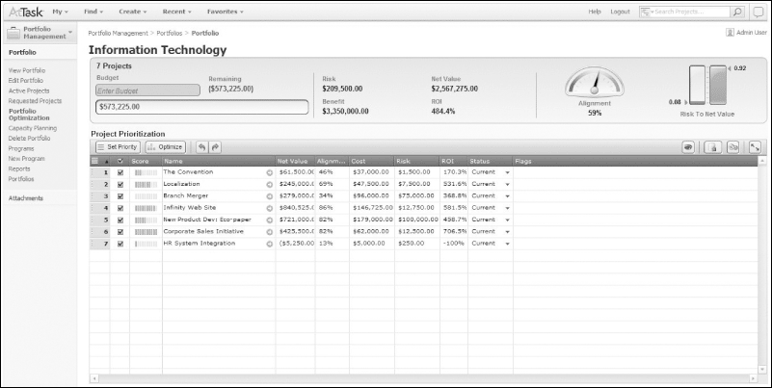
Figure 1-5. Sample Project Portfolio Management Screen Showing Portfolio Optimization

Slide 44
The Role of the Project Manager
Job descriptions vary, but most include responsibilities like planning, scheduling, coordinating, and working with people to achieve project goals
Remember that 97% of successful projects were led by experienced project managers, who can often help influence success factors

Slide 45
Suggested Skills for Project Managers
The Project Management Body of Knowledge
Application area knowledge, standards, and regulations
Project environment knowledge
General management knowledge and skills
Soft skills or human relations skills

Slide 46
Table 1-3 Ten Most Important Skills and Competencies for Project Managers
1. People skills
2. Leadership
3. Listening
4. Integrity, ethical behavior, consistent
5. Strong at building trust
6. Verbal communication
7. Strong at building teams
8. Conflict resolution, conflict management
9. Critical thinking, problem solving
10. Understands, balances priorities

Slide 47
Different Skills Needed in Different Situations
Large projects: Leadership, relevant prior experience, planning, people skills, verbal communication, and team-building skills were most important
High uncertainty projects: Risk management, expectation management, leadership, people skills, and planning skills were most important
Very novel projects: Leadership, people skills, having vision and goals, self confidence, expectations management, and listening skills were most important

Slide 48
Importance of Leadership Skills
Effective project managers provide leadership by example
A leader focuses on long-term goals and big-picture objectives while inspiring people to reach those goals
A manager deals with the day-to-day details of meeting specific goals
Project managers often take on the role of both leader and manager

Slide 49
Careers for IT Project Managers
In a 2011 survey, IT executives listed the “nine hottest skills” they planned to hire for in 2012
Project management was second only to programming and application development

Slide 50
Table 1-4. Nine Hottest Skills*
Skill |  | Percentage of Respondents
Programming and application development |  |  | 60%
Project management |  |  | 44%
Help desk/technical support |  |  | 35%
Networking |  |  | 35%
Business intelligence |  |  | 23%
Data center |  |  | 18%
Web 2.0 |  |  | 18%
Security |  |  | 17%
Telecommunications |  |  | 9%
*Source: Rick Saia, “9 Hot IT Skills for 2012,”
Computerworld, September 26, 2011.

Slide 51
The Project Management Profession
The profession of project management is growing at a very rapid pace
It is helpful to understand the history of the field, the role of professional societies like the Project Management Institute, and the growth in project management software

Slide 52
History of Project Management
Some people argue that building the Egyptian pyramids was a project, as was building the Great Wall of China
Most people consider the Manhattan Project to be the first project to use “modern” project management
This three-year, $2 billion (in 1946 dollars) project had a separate project manager and a technical manager

Slide 53
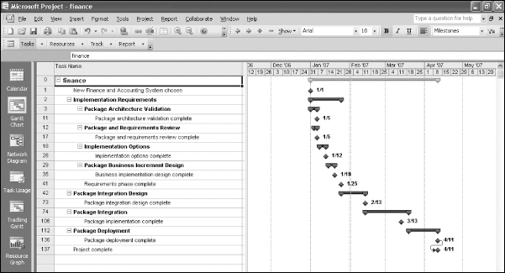
Figure 1-6. Sample Gantt Chart Created with Project 2010

Slide 54
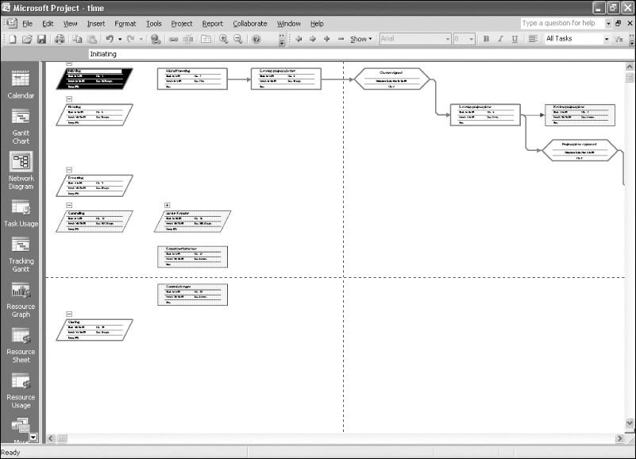
Figure 1-7. Sample Network Diagram Created with Project 2010

Slide 55
Project Management Offices
In the 100s, many companies began creating PMOs to help them handle the increasing number and complexity of projects
A Project Management Office (PMO) is an organizational group responsible for coordinating the project management function throughout an organization

Slide 56
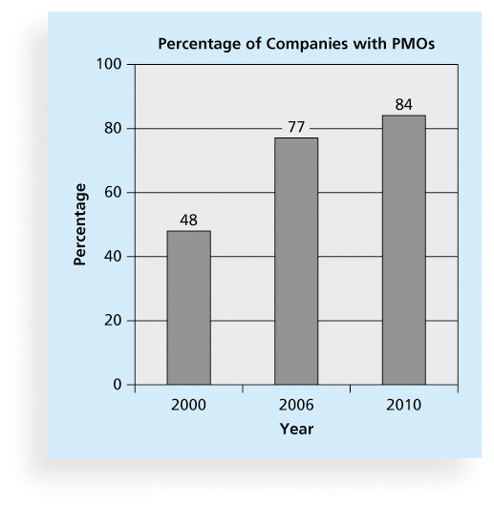
Figure 1-8. Growth in the Number of Project Management Offices

Slide 57
Global Issues
Several global dynamics are forcing organizations to rethink their practices:
Talent development for project and program managers is a top concern
Good project portfolio management is crucial in tight economic conditions
Basic project management techniques are core competencies
Organizations want to use more agile approaches to project management
Benefits realization of projects is a key metric

Slide 58
The Project Management Institute
The Project Management Institute (PMI) is an international professional society for project managers founded in 1969
PMI has continued to attract and retain members, reporting more than 380,000 members worldwide by 2012
There are communities of practices in many areas, like information systems, financial services, and health care
Project management research and certification programs continue to grow
Students can join PMI at a reduced fee and earn the Certified Associate in Project Management (CAPM) certification(see www.pmi.org for details)

Slide 59
Project Management Certification
PMI provides certification as a Project Management Professional (PMP)
A PMP has documented sufficient project experience, agreed to follow a code of ethics, and passed the PMP exam
The number of people earning PMP certification is increasing quickly
PMI and other organizations offer additional certification programs (see Appendix B)

Slide 60
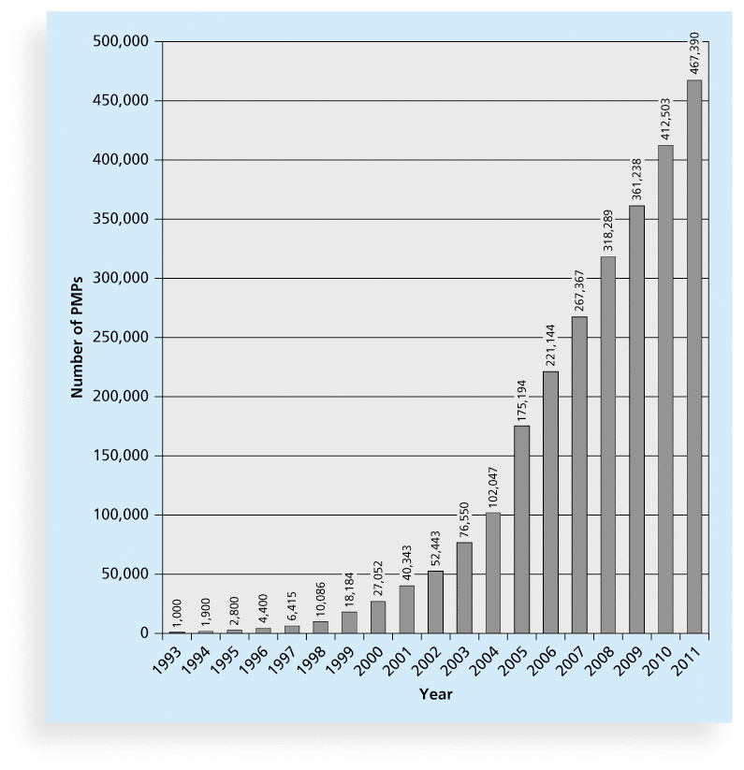
Figure 1-9 Growth in PMP Certification, 1993-2011

Slide 61
Ethics in Project Management
Ethics, loosely defined, is a set of principles that guide our decision making based on personal values of what is “right” and “wrong”
Project managers often face ethical dilemmas
In order to earn PMP certification, applicants must agree to PMI’s Code of Ethics and Professional Conduct
Several questions on the PMP exam are related to professional responsibility, including ethics

Slide 62
Project Management Software
There are hundreds of different products to assist in performing project management
Three main categories of tools:
Low-end tools: Handle single or smaller projects well, cost under $200 per user
Midrange tools: Handle multiple projects and users, cost $200-$1,000 per user, Project 2010 most popular
High-end tools: Also called enterprise project management software, often licensed on a per-user basis, like Microsoft Enterprise Project Management solution

Slide 63
Chapter Summary
A project is a temporary endeavor undertaken to create a unique product, service, or result
Project management is the application of knowledge, skills, tools, and techniques to project activities to meet project requirements
A program is a group of related projects managed in a coordinated way
Project portfolio management involves organizing and managing projects and programs as a portfolio of investments
Project managers play a key role in helping projects and organizations succeed
The project management profession continues to grow and mature

